Slide 1
Scale-Invariant Export Contents from I/O Tables
Luzius Meisser, University of Zurich
For the International Trade seminar by
Raphael Auer, Swiss National Bank
Philip Sauré, Swiss National Bank

Slide 2
Research Question
Given world input-output tables, estimate report reuse for each country.
Data source: world input-output database. 42 countries, 35 sectors, years 1995 – 2011. (Timmer et al. 2012)

Slide 3
Definition: Import Reuse
The fraction of exports that stems from earlier imports, accounting for circular trading between countries.
Sometimes also referred to as:
Import Reuse (Slides)
Import Contents of Exports (Broda 2008)
Foreign Content of Exports (OECD)
Foreign Value Added (Koopman 2012, Kee 2013)
Vertical Integration (Hummels 2001)
(Definitions vary. Not always consistent across sources.)

Slide 4
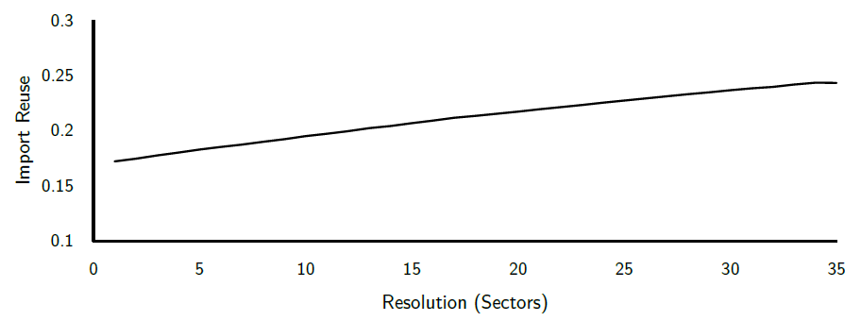
Problem: standard approach is not scale-invariant
Standard approach: Leontief inverse (e.g. Auer, Levchenko, Sauré 2016)
Implicitely assumes proportional use of inputs
Problem: result depends on resolution (Planting, 1991)

Slide 5
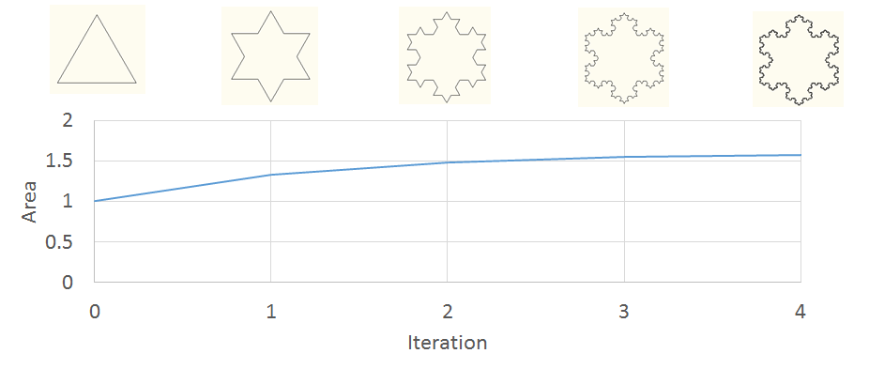
Fractal structure?
Area of Koch Island converges towards 1.6 as the level of detail is increased. Fractal, self-similar structure.

Slide 6
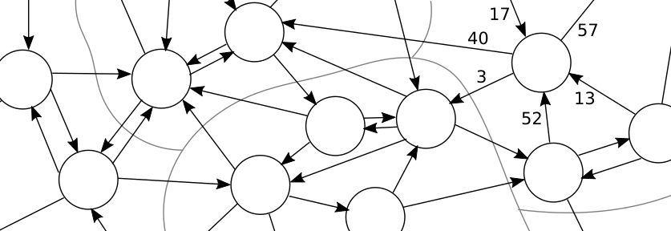
Graph View
Each matrix can be represented as a directed, weighted graph.
Equivalent to matrix view
Allows to apply graph algorithms

Slide 7
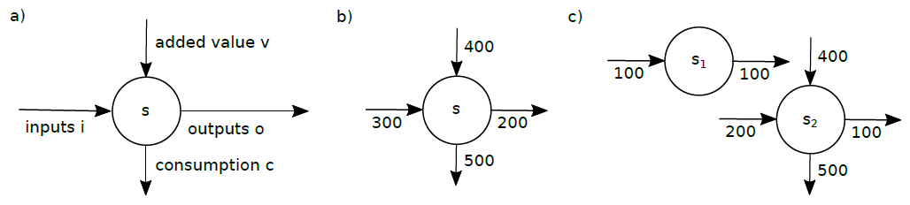
Merging Two Nodes
Merging the two nodes s1 and s2 results in the single node s.
Assuming inputs are all imports and outputs are all exports, import reuse declines from 66% to 43%.
b: reuse = 300 / (300 + 400) = 43%
c: reuse = (100 + 200 / (200 + 400) * 100) / (100 + 100) = 66%
Interpretation: s1 represents the firms of sector s that engage in processing trade only.

Slide 8
Resolution Curve Construction
Load complete graph
Calculate import reuse with Leontief inverse
Merge two randomly chosen nodes in each country
Repeat steps 1 to 3 until there is only one sector left per country (apart form the consumption node).
Repeat the above many times and report the average result to get a smooth curve.

Slide 9
Maxium Flow
Maximum Flow problem: what’s the maximum flow between two given nodes in a directed, weighted graph?
Edmonds-Karp algorithm is one of many to solve it.
Problem: not helpful. Provided theoretical bounds for import reuse are too wide, restricting processing trade only by a few percent.
E.g. if imports are 80 and exports 100, max flow might give a maximum import reuse of 77% and a minimum of 2%.

Slide 10
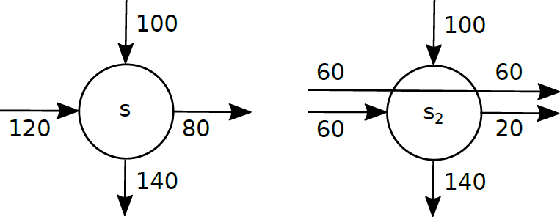
Adaptive Approach
Inspiriation: Koopman et al. 2008, Amiti et al. 2014, who find lots of “processing trade” in Belgium and China
Introducing an adjustable parameter «processing trade propensity» p to (virtually) split nodes.
Here, p=0.6 leads to processing trade of 60 = p avg(120, 80)

Slide 11
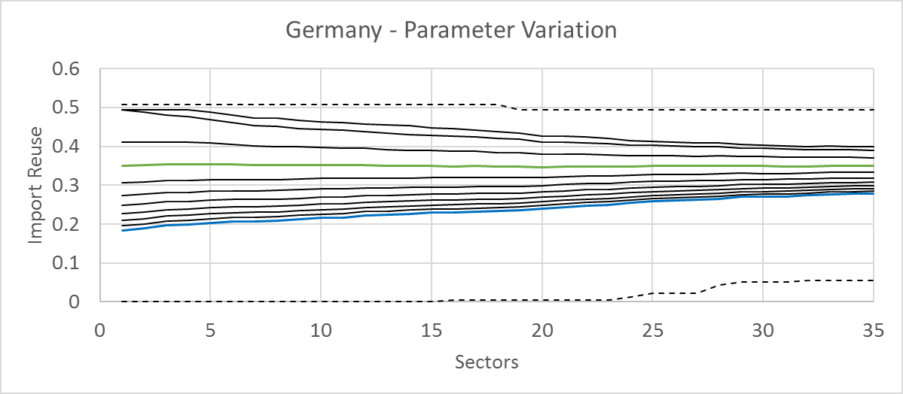
Adaptive Approach Scale-Invariance
Tuning the variable p to flatten reuse curve:
Min_p cov(sectors, importReuse(sectors, p))
Max Flow
p = 0.7
Leontief, p=0.0
Min Flow
Suggests that German import reuse is rather 35% (p=0.68) than 28%.

Slide 12
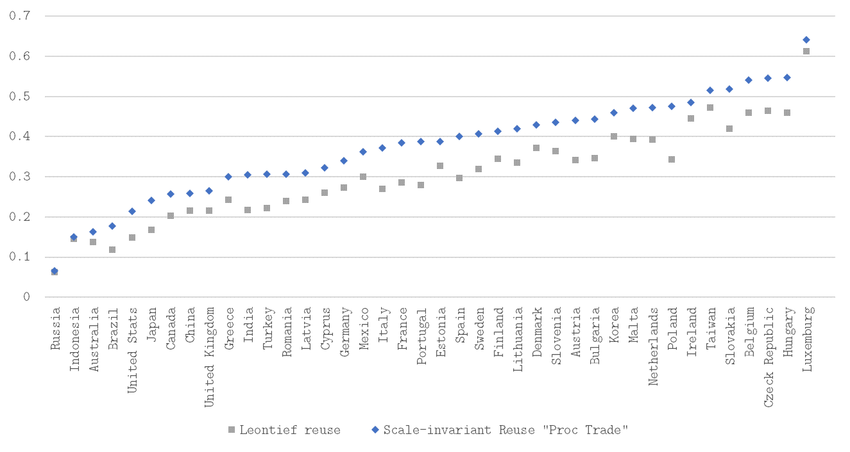
Resulting Import Reuse

Slide 13
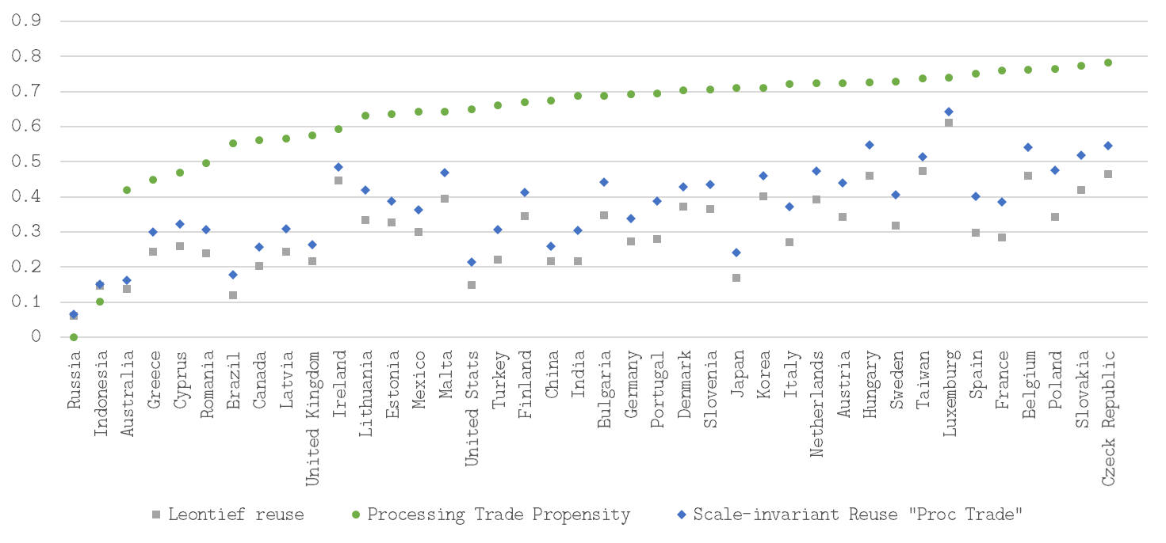
Processing Trade Propensity
Does this have a real meaning?
For example, it correlates better with economic complexity score (0.63) than Leontief reuse (0.53) aka «vertical integration».

Slide 14
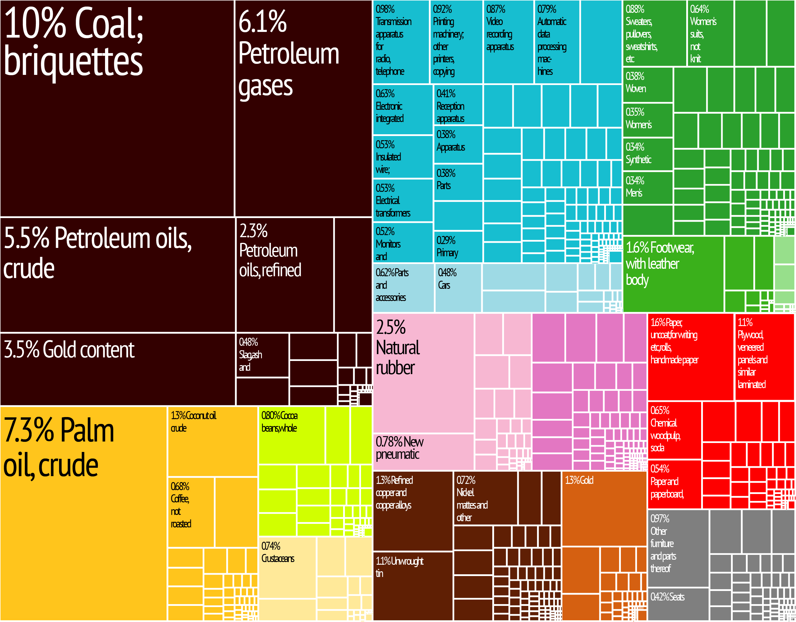
Indonesian Exports

Slide 15
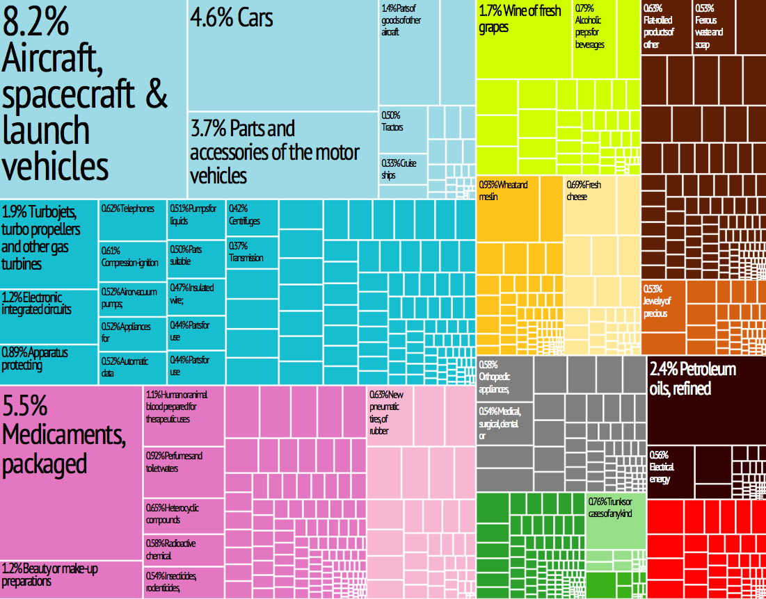
French Exports

Slide 16
Empirical Model
Having calculated p, does it help in explaining export reuse empirically?

Slide 17
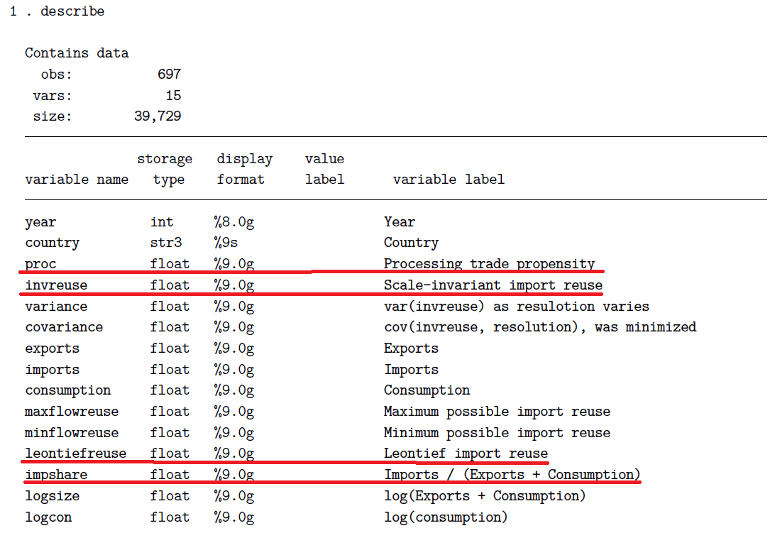

Slide 18
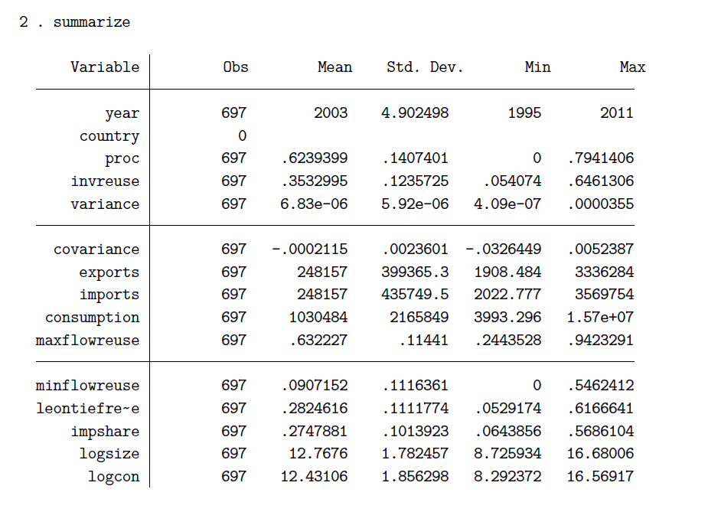

Slide 19
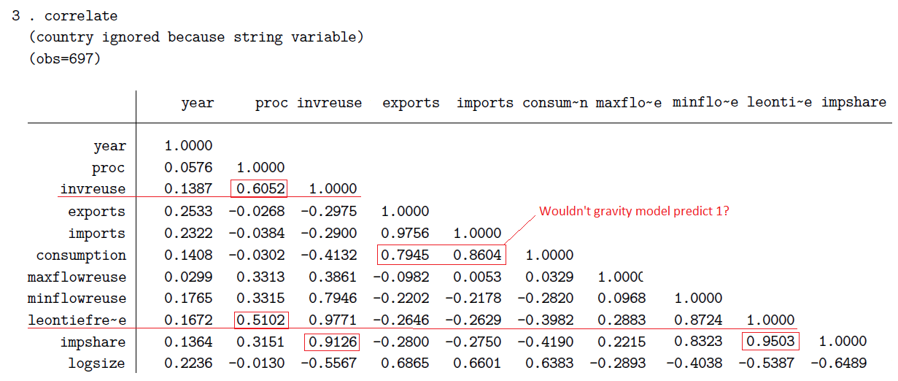

Slide 20
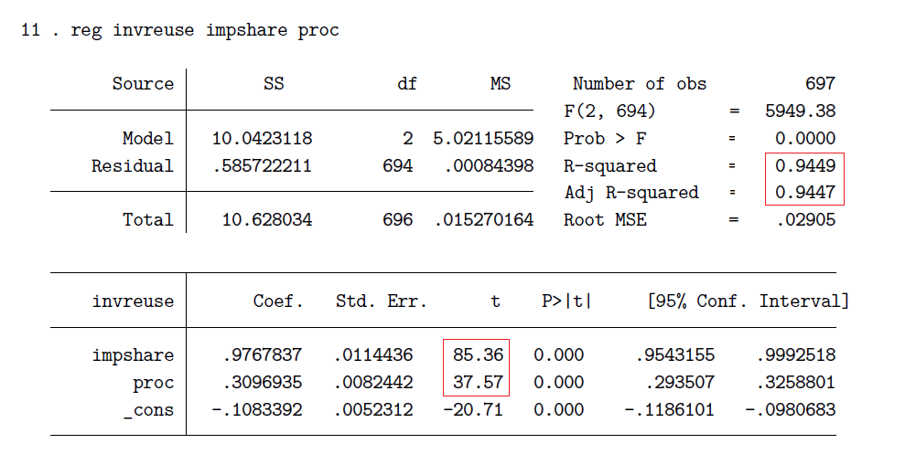

Slide 21
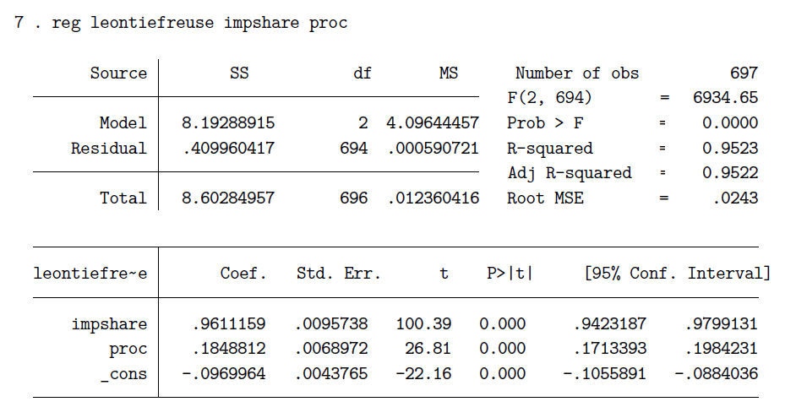

Slide 22
Reasonable?
If input-output graph is self-similar, the flat curve should represent the true import reuse
Self-similar graphs are scale-free, link distribution follows a power law
Gabaix 2016 argues power laws common in economics, Song et al 2005 see power laws and self-similarity often naturally appear in networks.
Chaney 2014 analyzes trade networks, resemblances to recipe to construct scale-free networks (Barabasi, Albert 1999)
Barabasi: “Probably the most surprising discovery of modern network theory is the universality of the network topology: Many real networks, from the cell to the Internet, independent of their age, function, and scope, converge to similar architectures.”
Link weight seem to indeed follow a power law
So far: very vague, qualitative argumentation
Would work better if sectors were composed of randomly chosen firms, and not similar ones.

Slide 23
Publishable?
What should be improved?
Refine flow bending (tested 9 candidates)
Comparison with more fine-grained data sources
More tangible definition of «scale-invariant» in this context. What kind of scale-free / power law do we need?
Micro-Foundations: is there a domestic consumption preference? Processing trade?
«Additive» when merging countries?
Other createria to detect whether variable makes sense?
What’s the highest ranking journal that is worth a shot? (i.e. > 10% success probability)

